Slide 1

 | MALLA REDDY COLLEGE OF ENGINEERING (Approved by AICTE, Permanently Affiliated to JNTUH) Recognised under Section 2(f) & 12(B) of the UGC Act 1956, An ISO 9001:2015 Certified Institution. Maisammaguda, Dhulapally, post via Kompally, Secunderabad - 500100
DEPARTMENT OF AI&DS
MAJOR PROJECT REVIEW-3
ACADEMIC YEAR:2024-2025
YEAR:4 SEM:2
DATE:09-06-2025

Slide 2
Detecting Malicious Twitter Bots Using Machine Learning
Presented By:
M. Pranathi - 21Q91A7225
G. Vinay - 21Q91A7243
P. Sai Gautham - 21Q91A7234
G. Venkata Koushik - 22Q95A7204
Under the Guidance of:
Dr. Sateesh Nagavarapu
Assoc Professor

Slide 3
CONTENTS :
ABSTRACT
INTRODUCTION
LITERATURE SURVEY
EXISTING SYSTEM/PROPOSED SYSTEM
MIN HARDWARE/MIN SOFTWARE REQUIREMENTS
ARCHITECTURE
MODULES
SAMPLE OUTPUT
CONCLUSION
REFERENCES

Slide 4
ABSTRACT :
Twitter is widely used by people, including politicians, media, and businesses, to share opinions on various topics. However, some accounts are bots that spread spam or misinformation.
Identifying these bots is important for user safety. In this study, we used machine learning—Logistic Regression and Random Forest—to classify accounts as real or fake based on Twitter profile features.
Random Forest performed better with 82% accuracy, while Logistic Regression achieved 70% accuracy.

Slide 5
INTRODUCTION :
Twitter is a popular and fast-growing social media platform where users share news, express opinions, and discuss current events. People can follow others with similar interests and post short messages called tweets. Tweets can be shared widely through retweets. Hashtags (#) help users find and follow topics, and popular ones become trending. Twitter is accessible on smartphones and computers. It's used during live events, for learning, and even for promoting products through paid ads. Following is one-way—you can see someone's tweets if their account is public, but they won’t see yours unless they follow you back.

Slide 6
LITERATURE SURVEY :
Karataş & Şahin [5] highlighted the growing threat of malicious social bots on platforms like Twitter and Facebook. These bots can act as scammers, spammers, impersonators, and more. The paper reviews detection methods and suggests future research directions.
Chavoshi et al. [6] proposed a novel bot detection method on Twitter using user activity correlation without needing labeled data. Their system clusters similar user behaviors using lag-sensitive hashing, achieving 94% accuracy and identifying bots missed by other methods.
Perdana et al. [7] focused on detecting Twitter bot spammers using time interval entropy and tweet similarity. Their combined approach outperformed single-feature methods, achieving 85.71% accuracy, 94.74% recall, and 90% F-measure.

Slide 7
EXISTING SYSTEMS :
Social media platforms like Facebook and Twitter have become a big part of our lives. Because of their popularity, many automated accounts, called bots, use these platforms too.
To detect bots, we look at a lot of data and pick out the most useful information using something called the Spearman correlation method.
Then, we use a tool called Random Forest to help us. It’s a type of program that uses many decision trees (like flowcharts) to analyze the data. By combining the results from all the trees, it gives more accurate predictions.
Disadvantages:
Low security

Slide 8
PROPOSED SYSTEMS :
We used Twitter data to find out which accounts are bots. First, we picked the most important data using the Spearman correlation method.
Then, we used Logistic Regression, a machine learning method, to predict if an account is a bot or not (output is 0 for not a bot, 1 for a bot).
We cleaned the data using pandas, a Python tool, and removed zero values. The model was trained with sample data and tested using real Twitter data.
Our model could also tell if a URL was malicious, with 73% accuracy.
Overall, the Logistic Regression model gave 74% accuracy in detecting bots. This shows our method works well with real-time Twitter data.
Advantages:
High security
High accuracy
High efficiency

Slide 9
HARDWARE/SOFTWARE REQUIREMENTS:
HARDWARE REQUIREMENTS:
Processor - Intel i3(min)
Speed - 1.1 Ghz
RAM - 4GB(min)
Hard Disk - 500 GB
Key Board - Standard Windows Keyboard
Mouse - Two or Three Button Mouse
Monitor - SVGA
SOFTWARE REQUIREMENTS:
Operating System - Windows10(min)
Programming Language - Python 3.7

Slide 10
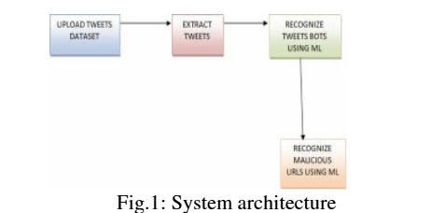
ARCHITECTURE:

Slide 11
MODULES:
1. Tweet Extraction Module
Purpose: To gather relevant data from Twitter for analysis.
Explanation:
This module uses the Twitter API to extract tweets and associated data.
It targets tweets that contain URLs, mentions, and hashtags, as these are commonly used by bots.
2. Recognize Twitter Bots Using Machine Learning
Purpose: To classify Twitter accounts as either bots or genuine users.
Explanation:
This module uses the features extracted from tweets (from the first module) and feeds them into a machine learning model.
3. Recognize Malicious URLs Using Machine Learning
Purpose: To identify whether a URL in a tweet is malicious (e.g., phishing, malware) or safe.
Explanation:
Extracted URLs from tweets are analyzed using URL-based features, such as:
Length of the URL.

Slide 12
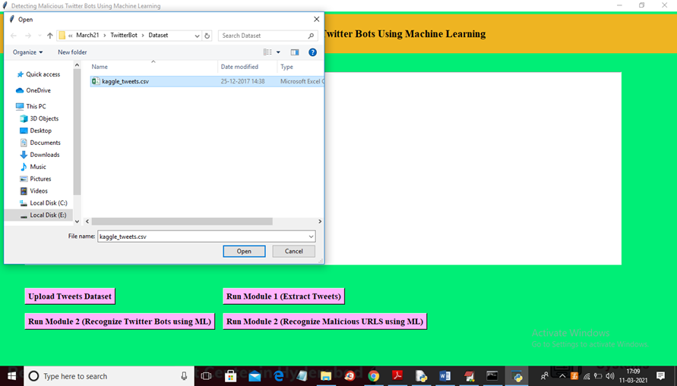
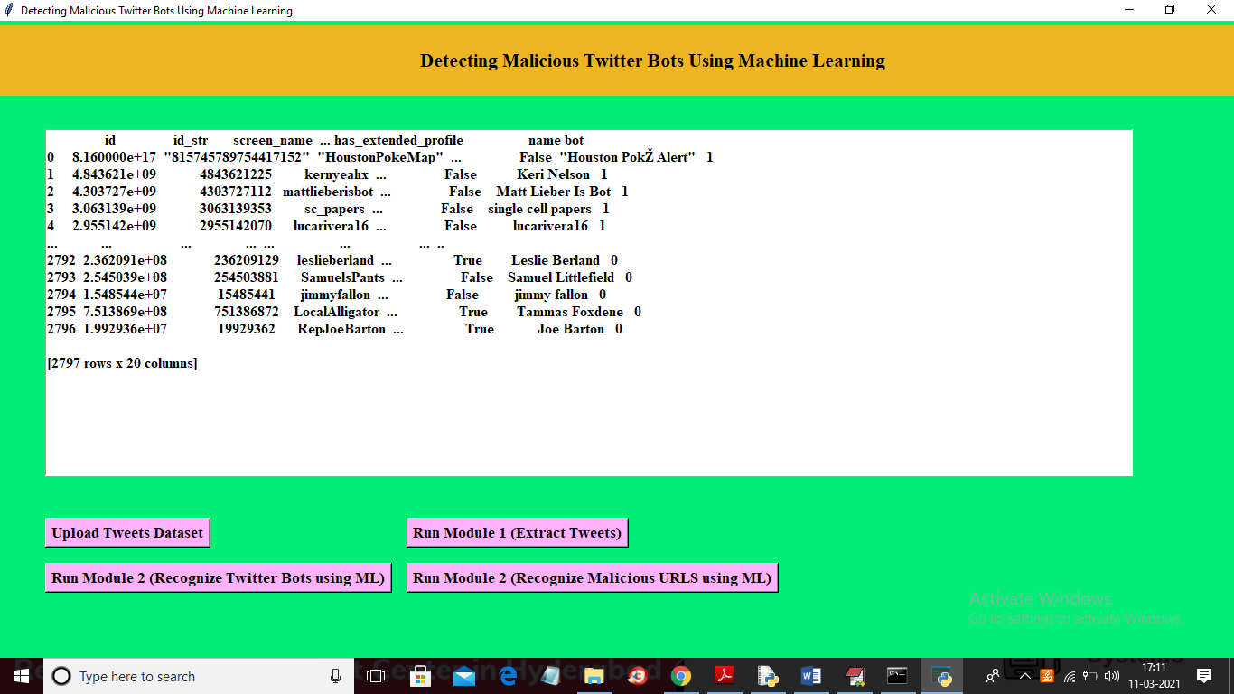
SAMPLE OUTPUT:
Select Kaggle Tweets Dataset
Extracting Tweets

Slide 13
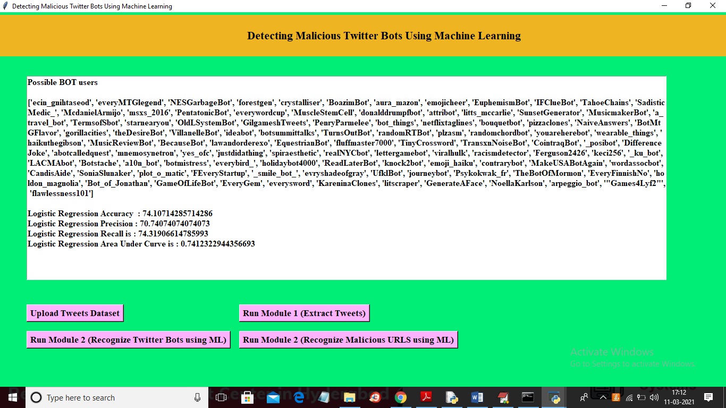
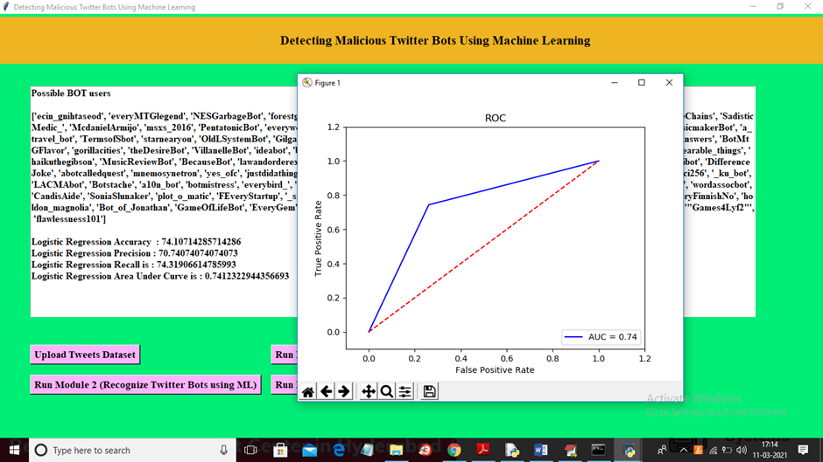
Recognized Bots
ROC Curve for detecting twitter bots

Slide 14
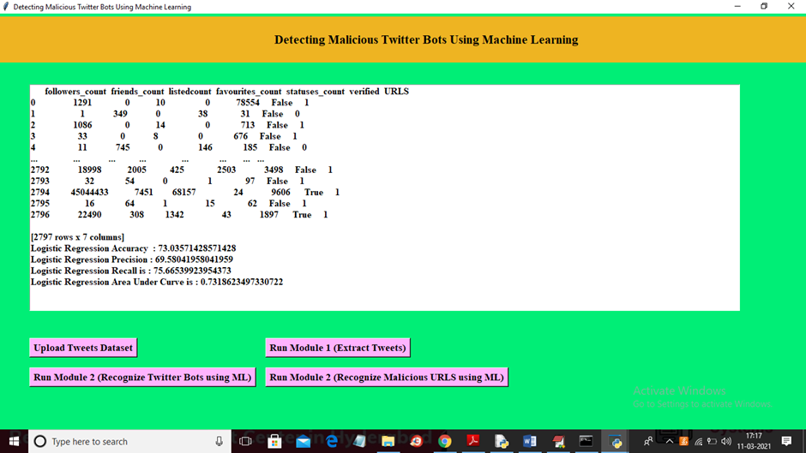
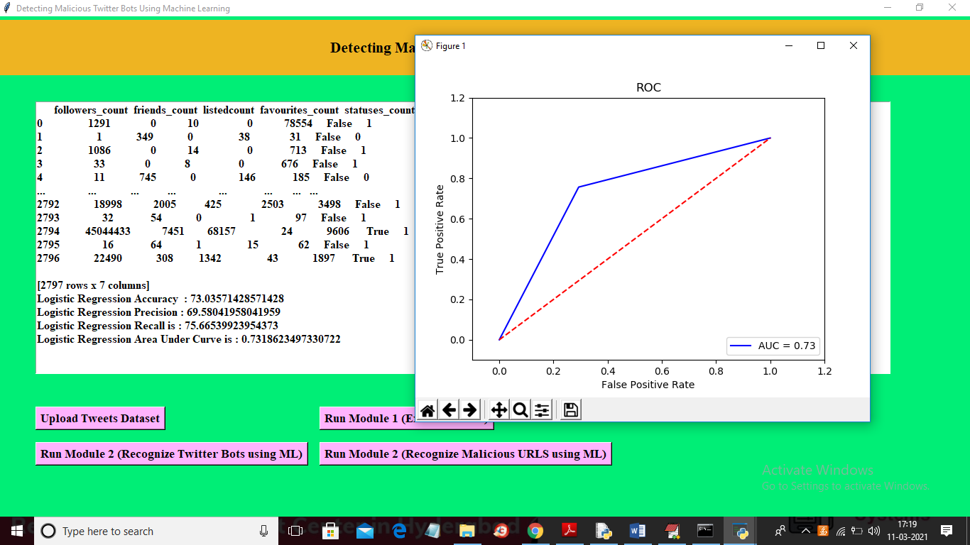
Detecting Malicious URLS
ROC Curve for detecting malicious urls

Slide 15
CONCLUSION :
We suggested an algorithm in our research that can identify Twitter bots. towards identify BOTS from tweets, Random forest was used. It contributed towards a decrease in cybercrime. In comparison towards decision tree, Multinomial Navie Bayes, bag about words algorithm was shown towards be best learning model, among an accuracy about 86.7% for train data& roughly 86.65% for test dataset. Thus, using real-time data & our machine learning algorithms, Twitter bots were successfully identified.

Slide 16
REFERENCES :
Van Der Walt, Estée, & Jan Eloff. "Using machinelearning towards detect fake identities: bots vshumans." IEEE Access 6 (2018): 6540-6549.
Sever Nasim, Mehwish, Andrew Nguyen, Nick Lothian, Robert Cope, & Lewis Mitchell. "Realtime detection about content polluters in partially observable Twitter networks." arXiv preprintarXiv:1804.01235 (2018).
Khalil, Ashraf, Hassan Hajjdiab, & Nabeel Al- Qirim. "Detecting Fake Followers in Twitter: AMachine Learning Approach." International Journal about Machine Learning & Computing7,no.6(2017).
Wetstone, Jessica & Sahil R. Nayyar. “I Spot a Bot: Building a binary classifier towards detect bots on Twitter.” (2017).
Karataş, Arzum, & Serap Şahin. "A Review on Social Bot Detection Techniques & ResearchDirections." In Proc. Int. Security & Cryptology Conference Turkey, pp. 156-161. 2017.

